Slide 1
Kurt Son
Data Analytics Portfolio

Slide 2
Projects
1. Gameco
2. Influenza
3. RockBuster
4. Instacart
5. Pig E. Bank
6. King County

Slide 3
Gameco: Overview
GameCo is a new video game company that is needing data analysis done to have a better understanding of how new games may fare in the market
The data consists of total number of units of games sold from 1980 to 2016. This information was attained from the website VGChartz
- Data Cleaning
- Data Grouping
- Descriptive Analysis
- Visualization
- Microsoft Excel
Objective
Tools and Skills
Data

Slide 4
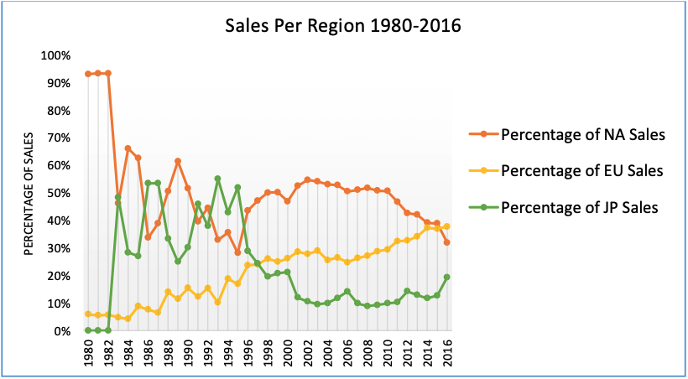
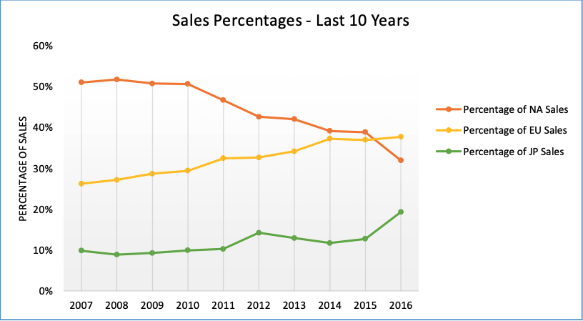
Gameco: Key Analysis
Historically, North America makes up a large portion of Global sales at nearly 50%, while Europe and Japan find themselves consuming less of the share.
In recent years, European sales have seen a notable surge which signals a growing market and demand. However, on the other end, North America has seen a substantial decline in sales. Japan has showed rather steady sales in the 10% - 20% range with rising market share.

Slide 5
Gameco: Recommendations
I highly recommend that the marketing team maintains the current budget for Japan, as it has yielded consistent results and has been rising in recent years.
I strongly recommend increasing the marketing budget for North American and European sales. This strategic move will enable us to seize the burgeoning opportunities and untapped potential present in the European market, ultimately bolstering our sales figures and fortifying our market presence. Additionally, implementing this course of action in North America will assist in rejuvenating the region's market, which has experienced persistent downturns in recent years.

Slide 6
Influenza: Project Overview
Objective
Data
Tools and Skills
To help a medical staffing agency that provides temporary workers to clinics and hospitals on an as-needed basis. The analysis will help plan for influenza season, a time when additional staff are in high demand.
- Data Cleaning
- Forecasting
- Visualization
- Data Integration
- Data Transformation
- Hypothesis Testing
- Microsoft Excel
Data sets were provided by the CDC as well as the US Census Bureau. The sets from the CDC contained information regarding influenza deaths by geography, time, age and gender as well as flu shot rates in children. The US Census Bureau provided population data
8

Slide 7
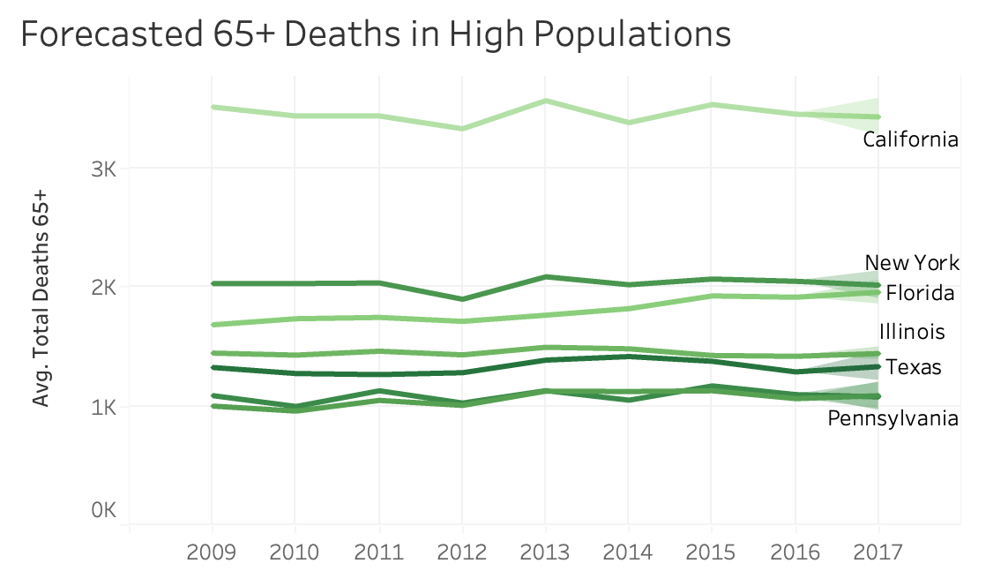
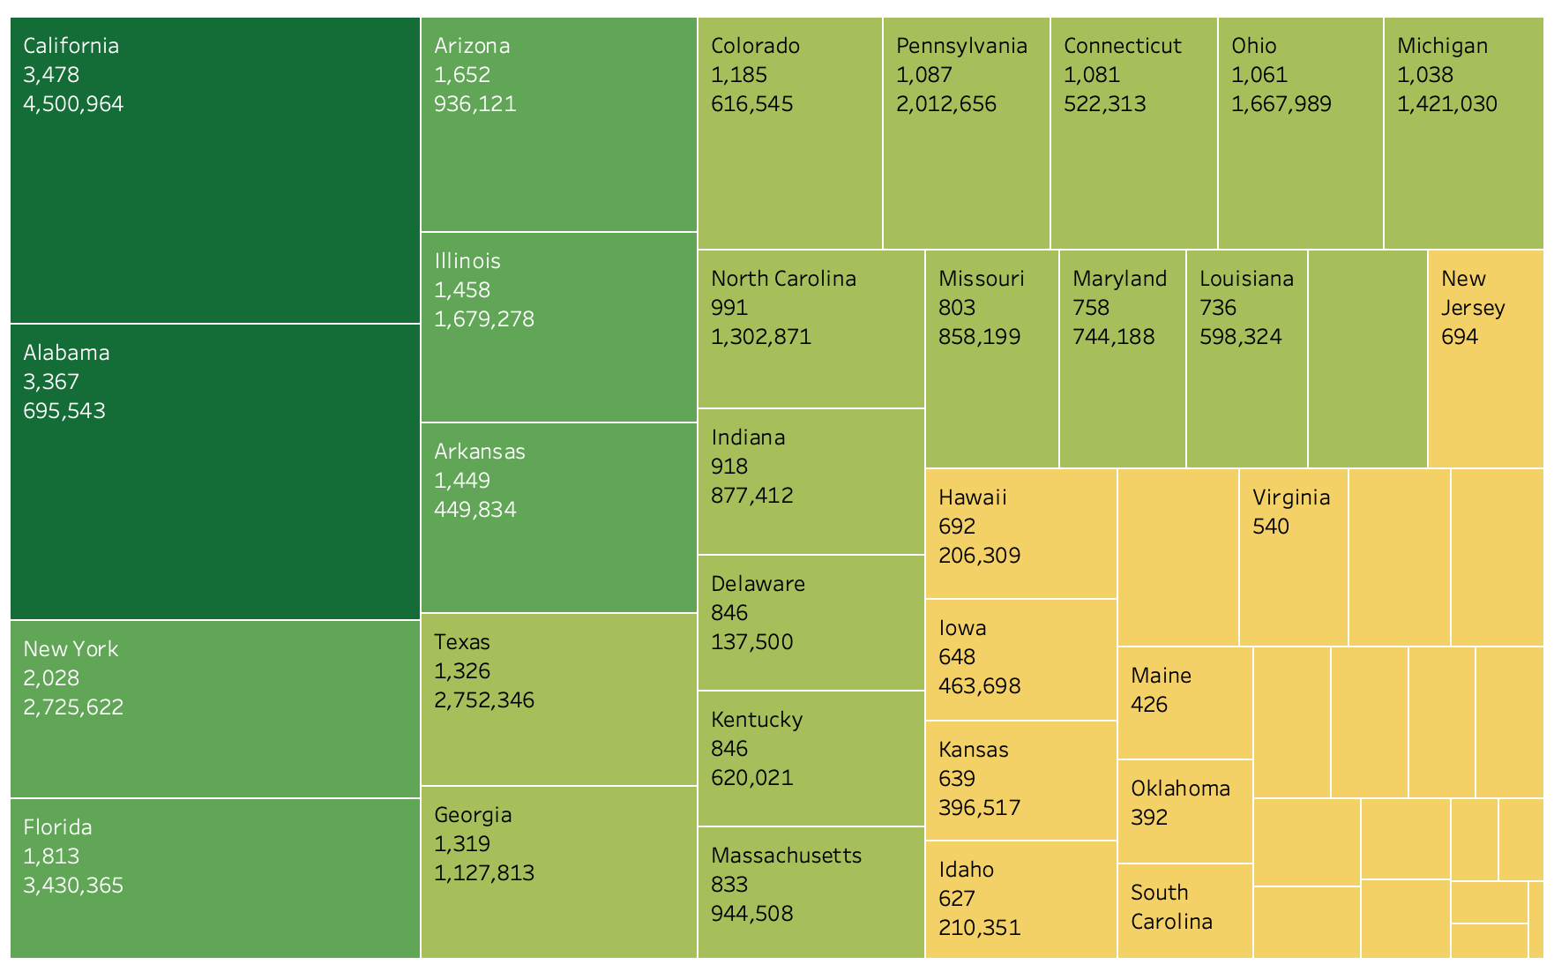
Influenza: Key Analysis
We can gather that a lot of states with larger populations of residents over 65, tend to have higher Influenza death tolls.

Slide 8
Influenza: Recommendations
Begin sending higher numbers of staff to the states with higher populations of 65+. Specifically targeting the largest populations in California, Florida, New York and Illinois

Slide 9
Rockbuster: Project Overview
Objective
Data
Tools and Skills
Facing stiff competition from streaming services such as Netflix and Amazon Prime, the RockBuster Stealth management team is planning to use its existing movie licenses to launch an online video rental service in order to stay competitive.
- PostgreSQL
- Tableau
- Relational Databases
- Joining Tables
- Subqueries
- Common Table Expressions
RockBuster’s databases containing customer, employee and inventory information

Slide 10
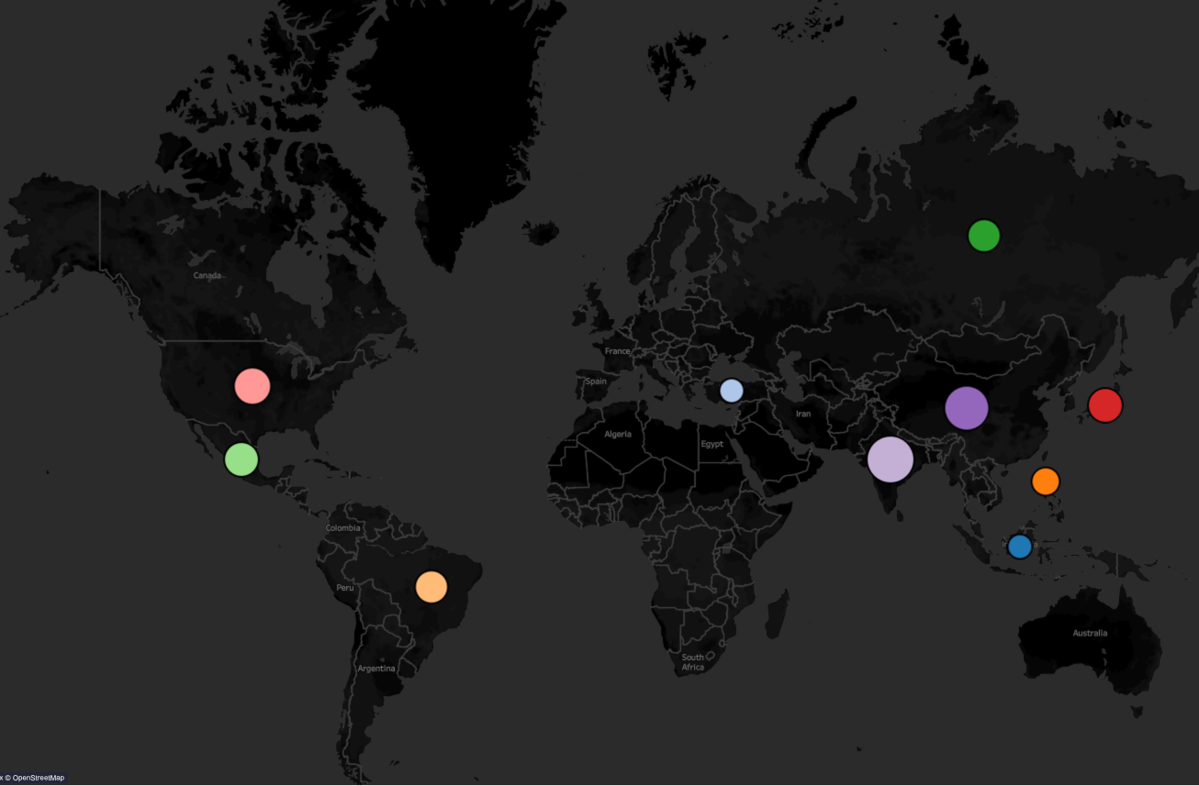
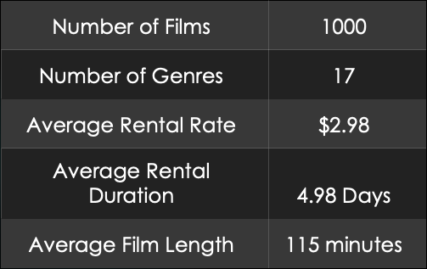
Rockbuster: Key analysis
Rockbuster consists of customers in 109 different countries.
India is the largest market for RockBuster followed in order by the following: China, United States, Japan, Mexico, Russian Federation, Brazil, Phillipines, Turkey and Indonesia

Slide 11
Rockbuster: Recommendations
Remove the most unpopular titles
Push for movies in different languages to be added as the only language available is English and the company is worldwide
Specifically focus on titles and genres that are popular in India and put the most efforts forward in that market as it has the highest market share

Slide 12
Instacart: Project Overview
Objective
Data
Tools and Skills
Perform an initial data and exploratory analysis of some of their data in order to derive insights and suggest strategies for better segmentation.
- Python
- Jupyter Notebooks
- Data Cleaning
- Data Merging
- Descriptive Statistics
-Data Grouping and Aggregation
- Common Table Expressions and Subqueries
Dataset used was directly from Instacart titled “The Instacart Online Grocery Shopping
Dataset 2017” .

Slide 13
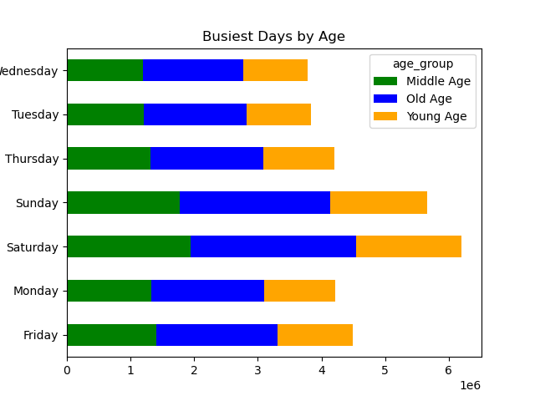
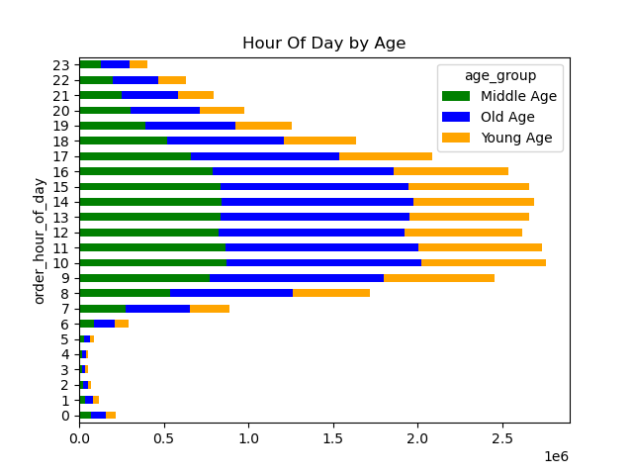
Instacart: Key Analysis
The busiest days are Saturday and Sunday, while the busiest hours are from 9 AM to 4 PM.
These charts also depict that customers that fall into the ”old age” category, use Instacart the most.

Slide 14
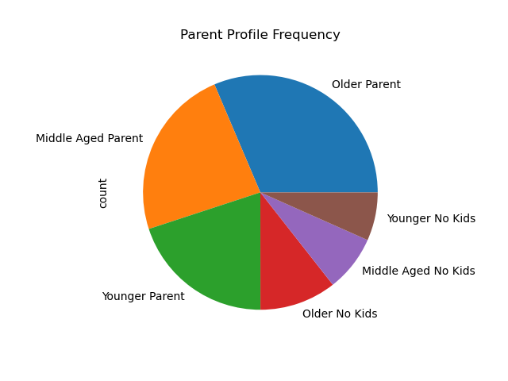
Instacart: Key Analysis
The Pie chart shows the frequency of shoppers using Instacart, with a bulk majority of the users falling in the old age category. However, we can also see that users that fall into the "parent" category account for around 75% of purchases.

Slide 15
Instacart Recommendations
Focus ads and promotions on the following:
Parents
Busy hours where customers are typically the most active
Produce items as they are the most popularly purchased
Incentivizing loyal customers

Slide 16
Pig E. Bank: Project Overview
Objective
Tools and Skills
Data
Provide analytical support to Pig E. Bank’s anti-money-laundering compliance department
- Microsoft Excel
- Github
- Big Data
- Data Mining
- Predictive Analysis
- Time Series Analysis and Forecasting
Data provided by Pig E. Bank

Slide 17
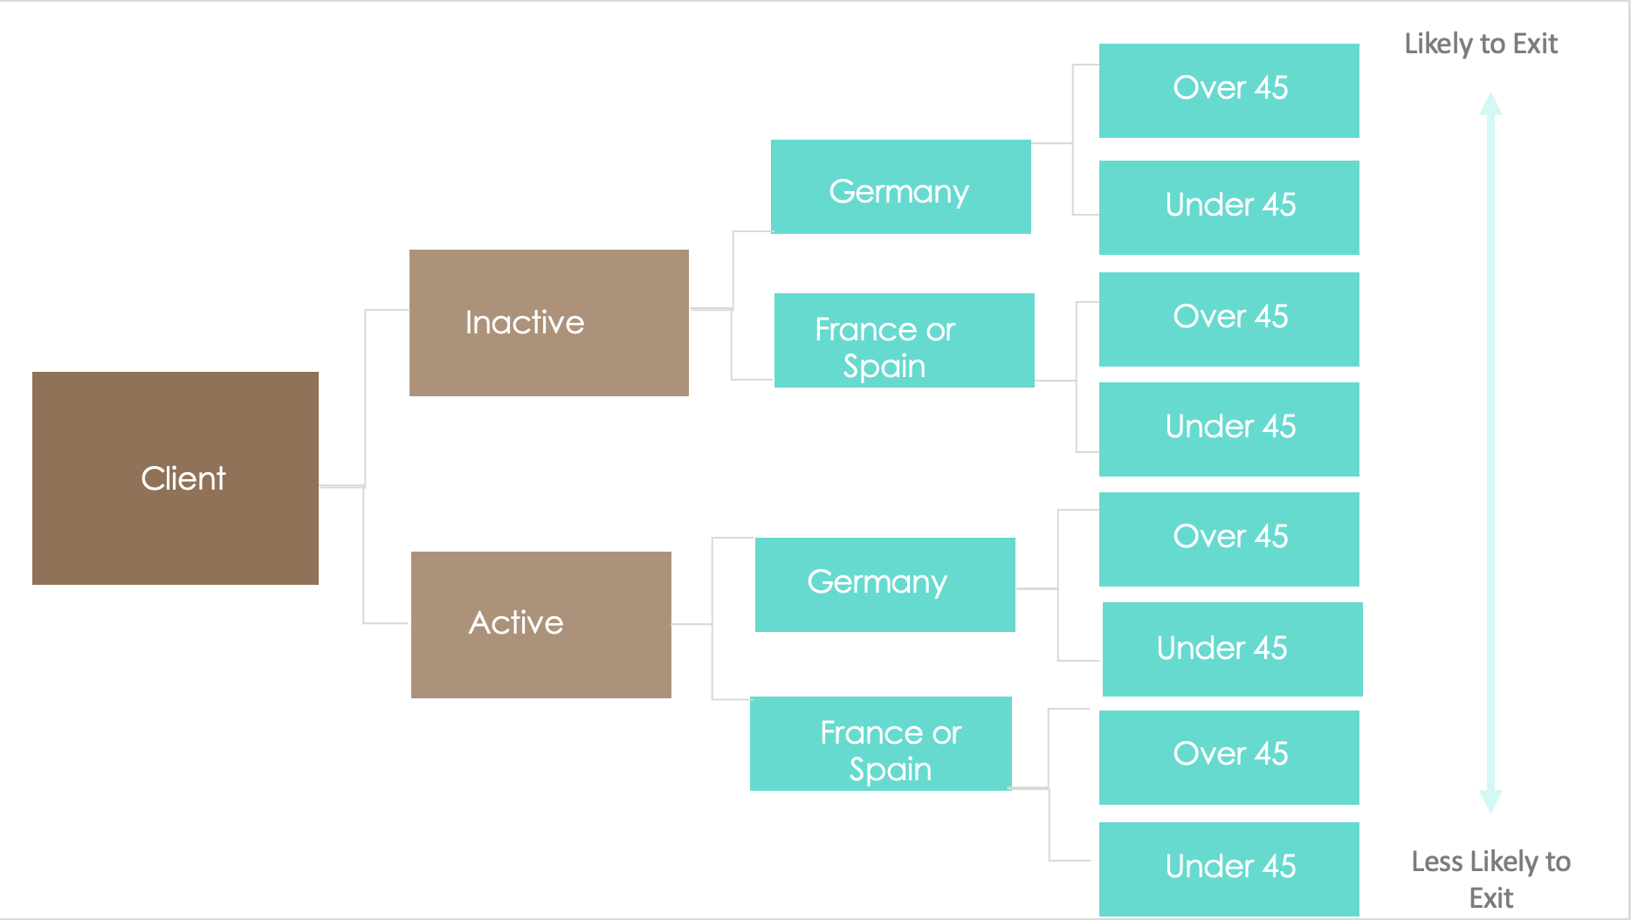
Pig E. Bank Decision Tree
The main factors causing employees to exit:
1. Inactive users
2. Being over the age of 45
3. Being located in Germany

Slide 18
King County
In this case study, we'll be analyzing what primarily informs the price of real estate in King County, Washington. This analysis is intended to educate buyers on housing costs and to provide education to improve the buying experience.

Slide 19
King County: Project Overview
Objective
Data
Tools and Skills
In this case study, we'll be analyzing what primarily informs the price of real estate in King County, Washington. This analysis is intended to educate buyers on housing costs and to provide education to improve the buying experience.
- Python
- Tableau
- Data Cleaning
- Data Merging
- Spatial Analysis
- Subqueries
- Common Table Expressions
House Sales in King County, USA

Slide 20
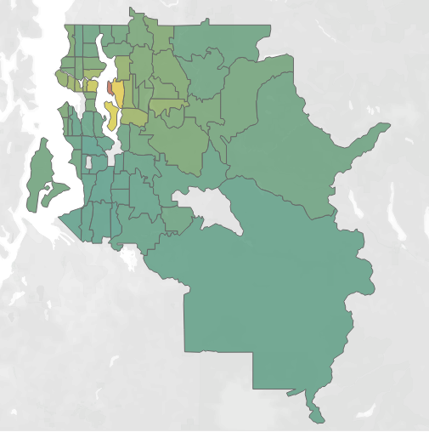
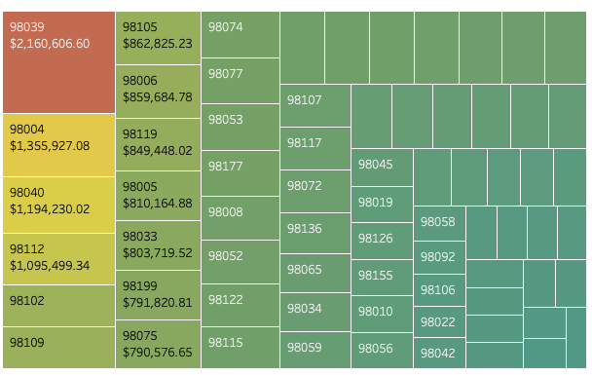
King County Key analysis

Slide 21
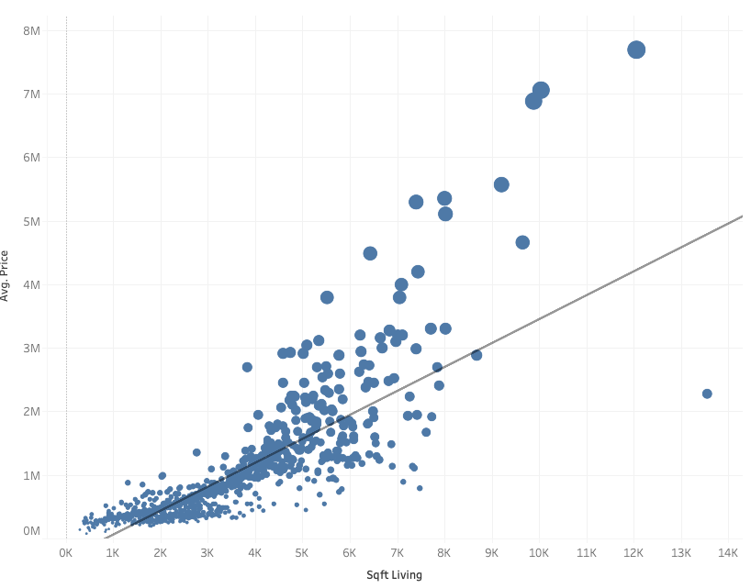
King County Key Analysis
To test this hypothesis, we conducted a linear regression.
The results show a moderate relationship with a coefficient of .49. This demonstrates that there is a relationship between the two variables at play and is very close to being a strong relationship.

Slide 22
King County: Key Findings
Zip Code 98039 has substantially larger home costs. This is largely due to geographical location in being so close to Seattle.
The homes with more living space are indeed going to be pricier. This was proven to be mostly true in our linear regression model with a 0.49 coefficent and further analyzed in the cluster analysis
Waterfront housing is at a premium. If you want to live on the water, you will have to pay a pretty penny. Prices for waterfront property will be costing substantially more on average in King County.

Slide 23
Resources
Follow the links below for additional project resources
Github
Tableau

